Slide 1
Category review: Chips
June 2020
Retail Analytics
Brand note: If client logo is not required, use alternate title page layout right click slide thumbnail > Layout > Title

Slide 2
Notes:
To view Privacy video explaining how important data privacy is to Quantium, please click here: https://www.youtube.com/watch?v=Zq1QDAkoRzU
or here Q:\Company Reference\Brand & Design\Brand videos\Q Privacy.mp4
At Quantium, we believe that data is the behavioural footprint of humanity and that it has to be treated with the utmost care and responsibility.
Histories, attitudes, indeed lives are stored within it in ways that aren’t always apparent – and that’s what makes its potential so powerful.
To work with it responsibly, sensitively, we set ourselves the highest data privacy protection and governance standards.
We have spent 17 years perfecting privacy-by-design and secure-by-design principles. Central to this is not holding any personally identifiable information about people –
we neither receive it, and put the necessary protections in place to be unable to decipher it.
Every aspect of handling data is safeguarded: from its de-identification, to its encryption – data security is paramount and of the highest grade.
We pride ourselves on gaining the trust of iconic organisations around the world through years of securely working with their data,
and in turn the trust that builds with their stakeholders.

Slide 3
Executive summary
01
Task 1
Highest Proportion of Customers Contributing to Total Sales are Older Families Belonging to the Budget group at 8.69%
Highest Proportion of Customers by Demographic and Type are Young Singles / Couples at 11.11%
02
Task 2
Here you will include your high-level findings and any key callouts for task 2

Slide 4
01
Category

Slide 5

Overview: Customer Demographic Distribution

Slide 6

Overview of Demographics and Affluence
Mainstream Young Singles and Couples are the Highest Proportion of Customers at 11.11%
Yet Sales for this Group is 8.18%
Older Singles / Couples have Relatively the Same Proportion Across Affluence Groups
The Highest Proportion of Customers are Retirees at 20.42%

Slide 7

Editable (delete this)
Overview: Customer Demographic Distribution by Total Sales

Slide 8
02
Trial store performance

Slide 9
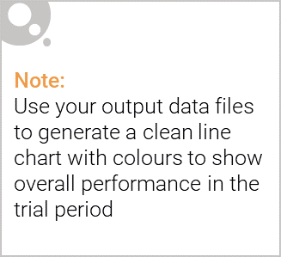
Explanation of the control store vs other stores
Looked at similar customer counts and sales for each store
Examined Pearson Correlations for sales and customer counts
Calculated a composite score
½ Difference between customer counts and sales
½ Looking at Correlations between customer counts and sales

Slide 10

Customer Counts Comparing Pre-Trial Period and Trial Period
All Stores Had an Increase of Customer Activity Between February and April
All Were Statistically Significant (p-value < 0.05 using T-Test)

Slide 11
Sales Performance Pre-Trial vs. Trial Period

